Slide 1


SMART POLYPHARMACY AND VITAMIN RECOMMENDATION SYSTEM
Group ID : 25 – 26J - 368

Slide 2

Our Team
Group ID : 25 – 26J – 368
Supervisor - Ms. Jenny Krishara
Co-supervisor - Dr. Dinuka Wijendra
Student Name | Student ID
Reshmi M.G.G.K | IT22600448
Jeesara K.G.N | IT22561084
Jayalath J.P.R.J | IT22591098
Tharaka B.W.P | IT22600516

Slide 3


INTRODUCTON TO PROBLEM
Our study focuses on evaluating the market landscape, patient needs, and competitive factors relevant to the Smart Polypharmacy and Vitamin Recommendation System.
Our study aims to explore challenges, assess feasibility, and provide insights for a Smart Polypharmacy and Vitamin Recommendation System.
01
SCOPE OF THE STUDY
Understanding the market implications of a Smart Polypharmacy and Vitamin Recommendation System is crucial for staying competitive and meeting evolving patient needs.
02
RELEVANCE OF THE STUDY
How can a Smart Polypharmacy and Vitamin Recommendation System meet patient needs, use health-tech trends, and stand out in the market?
03
RESEARCH QUESTION

Slide 4

Social or research impact of the solution
1.
🩺 Better patient health
reduces risks from drug interactions & unnoticed vitamin deficiencies.
👵 Improved elderly care
supports healthier aging and quality of life.
2.
📊 Data-driven insights
enables research on polypharmacy patterns & deficiencies.
4.
3.
🌍 Scalable impact
potential to shape policies and practices in geriatric healthcare.
🤖 Advances digital health
contributes to AI-powered healthcare innovation.

Slide 5




Previous Research & Shortcomings
🔎 Previous studies focused mainly on :
General polypharmacy risk detection
Nutritional guidance without integration to medication profiles
Isolated AI models lacking personalization
💡 Our Approach:
Shortcomings
Integrating polypharmacy risk scoring with vitamin deficiency detection
Providing personalized meal plans & lifestyle guidance
Using AI-driven, patient-centered design
Limited focus on geriatric patients
No combined system for drug interaction + vitamin deficiency monitoring + meal plan +life style guidance .
Lack of real-time, personalized recommendations.

Slide 6

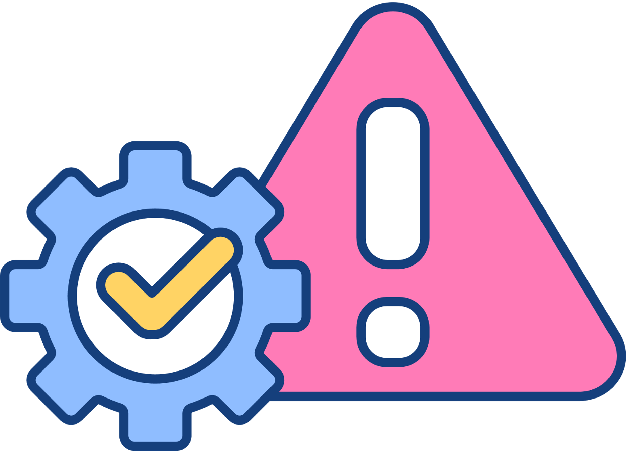
CONSTRAINTS & LIMITATIONS
📉 Data Constraints – limited availability of high-quality, longitudinal datasets
🧪 Validation Challenges – need for clinical trials to confirm accuracy and safety
💻 Tech Limitations – dependency on AI/ML accuracy and potential bias
👩‍⚕️ Adoption Barriers – resistance from patients/healthcare providers to new digital tools
💰 Resource Constraints – cost and infrastructure for large-scale deployment

Slide 7
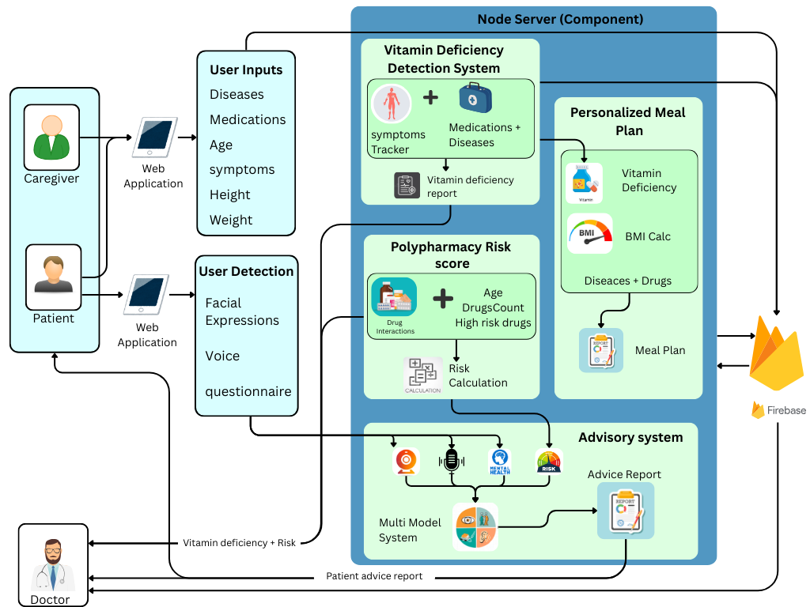
Overall solution as a system diagram

Slide 8

It22600448 | Reshmi m g g k
EARLY VITAMIN DEFICIENCY WARNING SYSTEM BASED ON SYMPTOMS AND LONG-TERM MEDICATION
Specialization : Information Technology
IT22600448 | Reshmi M.G.G.K | 25-26J-368

Slide 9

Proven Gap / Creative Solution
Feature / Aspect | Research (1) [CNN Image Detection] | Research (2) [Neural Network Image Based] | Research (3) [Expert System Forward Chaining] | Research (4) [Expert System Mobile-Based] | Proposed Solution (Symptom + Medication-Based Warning)
Multi-vitamin detection | NO | NO | NO | NO | YES
Integration with long-term medication | NO | NO | NO | NO | YES
Symptom-based early warning | NO | NO | YES | YES | YES
AI / ML-driven analysis | YES | YES | NO | PARTIALLY | YES
Multi-factor health data (diet, lifestyle, medication) | NO | NO | NO | NO | YES
Non-image input (symptoms & history) | NO | NO | NO | NO | YES
IT22600448 | Reshmi M.G.G.K | 25-26J-368

Slide 10




HOW OUR SOLUTION ADDRESSES EXISTING GAPS
Research 2: Neural Network Image Based)
Research 1: Symptom-Based Tracking Apps
Limitation: Current methods detect deficiencies only after severe symptoms appear.
Gap: Lack of proactive, early-warning detection.
Our Solution: AI-powered system provides early alerts based on subtle symptom analysis.
Limitation: Only track current symptoms.
Gap: Doesn’t consider long-term medication effects.
Our Solution: Integrates symptom tracking with medication history for early deficiency alerts.
Research 4: Wearable-Based Health Monitoring
Research 3: Expert System Forward Chaining
Limitation: Single metrics, snapshot-based data.
Gap: No longitudinal tracking or predictive warnings.
Our Solution: Uses long-term symptom tracking and predictive models for proactive alerts.
Limitation: Provide generic dietary advice, not customized for age, health conditions, or medications.
Gap: Lack of personalized guidance for high-risk populations, especially older adults or those on long-term medication.
Our Solution: System delivers personalized vitamin recommendations based on individual age, health conditions, lifestyle, and medication history.
IT22600448 | Reshmi M.G.G.K | 25-26J-368

Slide 11









COMPONENT-SPECIFIC DETAILS / SYSTEM VALIDATION
Predictive Modeling Component:
Uses symptom + medication history to predict deficiencies
Technology: LSTM/Transformer neural networks for temporal data
Data & Ethics:
Input: Patient symptom logs, prescription data, lab results
Output: Personalized deficiency warnings, dietary recommendations
Ethical considerations: Informed consent, anonymization, secure storage
Personalized Recommendation Component:
Suggests deficiency level tailored to patient profile
Technology: Expert system + ML-based recommendation engine
Success Evaluation:
Validation against clinical vitamin test results
Metrics: Accuracy, Precision, Recall, F1 Score
Longitudinal tracking to measure early detection over months
IT22600448 | Reshmi M.G.G.K | 25-26J-368

Slide 12


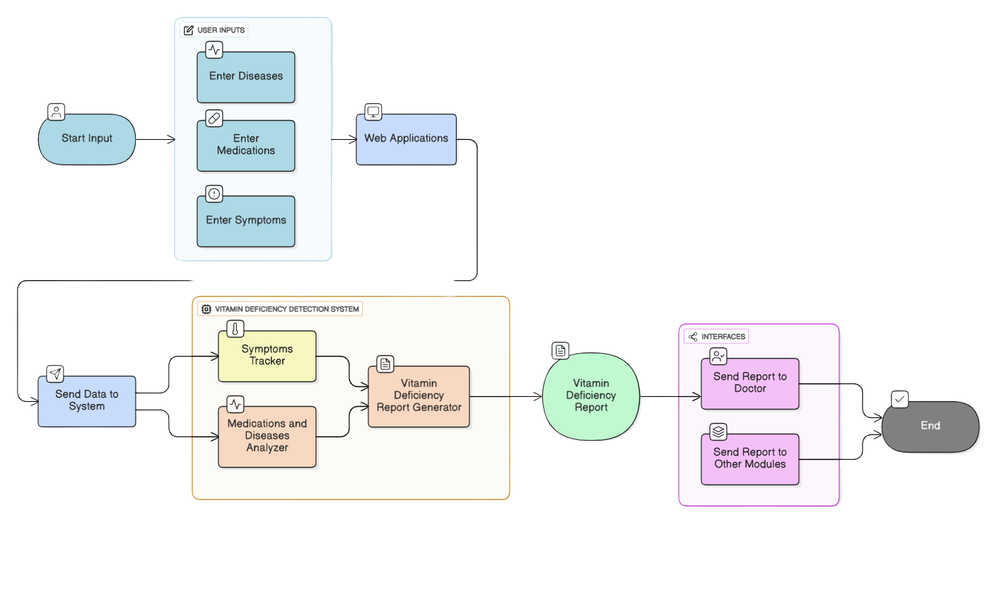

COMPONENT DIAGRAM
IT22600448 | Reshmi M.G.G.K | 25-26J-368

Slide 13
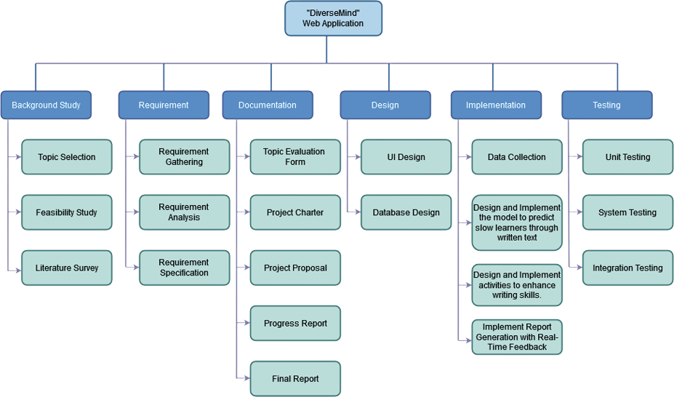
Web app implementation
Design and
implement the
system
IT22600448 | Reshmi M.G.G.K | 25-26J-368

Slide 14

It22561084 | JEESARA k g n
PERSONALIZED MEAL PLAN RECOMMENDATION SYSTEM FOR VITAMIN DEFICIENCY
Specialization : Information Technology
IT22561084 | Jeesara K G N | 25-26J-368

Slide 15
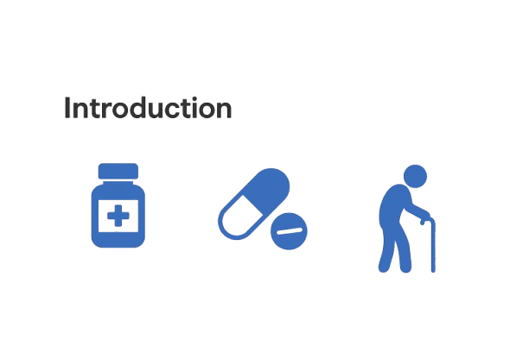
Introduction
PERSONALIZED MEAL PLAN RECOMMENDATION SYSTEM FOR VITAMIN DEFICIENCY
Generic meal charts do not address the individual needs of elderly patients.
Polypharmacy patients require special meal planning that avoids harmful drug-nutrient interactions.
Standard diet apps focus on calories and weight loss, not on vitamin deficiency management.
Our Meal Plan Module:
Generates personalized, culturally appropriate meals.
Adjusts according to age, BMI, drug history, and food preferences.
Recommends vitamin-rich foods (e.g., B12 for long-term metformin use).
Provides adaptive updates as the patient’s drugs or health status change.
IT22561084 | Jeesara K.G.N | 25-26J-368

Slide 16


Research Gap
PERSONALIZED MEAL PLAN RECOMMENDATION SYSTEM FOR VITAMIN DEFICIENCY
Features | Research 1 | Research 2 | Research 3 | Research 4 | Proposed
Integration of deficiency detection and dietary intervention
Incorporation of patient-specific factors (e.g., age, BMI, drug profile, dietary preferences)
Targeted management of vitamin deficiencies caused by polypharmacy
Adaptability and dynamic updates to meal plans based on changes in drug regimens or health status
Consideration of drug-nutrient and nutrient-nutrient interactions
IT22561084 | Jeesara K.G.N | 25-26J-368

Slide 17
Overview of Shortcomings
PERSONALIZED MEAL PLAN RECOMMENDATION SYSTEM FOR VITAMIN DEFICIENCY
Research Gap
Shortcomings in the Existing System
How to Address it
AI tools detect deficiencies but lack dietary interventions, leaving patients without solutions
Integrates the Early Vitamin Deficiency Warning System with dynamic meal plans, ensuring seamless detection and intervention.
Lack of Integration Between Detection and Intervention
Insufficient Patient-Specific Diet Recommendations
Nutrition apps give generic advice, ignoring age, BMI, drug profiles, or preferences, unsuitable for polypharmacy
culturally appropriate meals using patient data and drug–nutrient interactions for safer care.
Generalized Management of Drug-Induced Deficiencies
AI models focus on broad health data, not polypharmacy-specific deficiencies missing elderly risks
Targets drug-induced deficiencies with precise interventions (e.g., folate-rich greens for PPI users), focusing on polypharmacy needs
Limited Adaptability and Polypharmacy Focus
AI meal planners prioritize general goals lacking dynamic updates or provider reports
Adapts plans in real-time to health/drug changes, provides documented reports for providers, ensuring evidence-based care.
IT22561084 | Jeesara K.G.N | 25-26J-368

Slide 18
Methodology
PERSONALIZED MEAL PLAN RECOMMENDATION SYSTEM FOR VITAMIN DEFICIENCY
Development Stages
Patient Data Collection - Gather age, height, weight, medication history, and preferences from patient inputs.
Deficiency Analysis - Early Vitamin Deficiency Warning System uses CNNs to identify deficiencies.
Personalized Diet Planning - Personalized Meal Planner generates adaptive, culturally appropriate diets based on patient data, avoiding drug-nutrient conflicts.
Validation and Testing - Conduct a 6-month clinical trial to measure adherence (>80%), deficiency reduction
User Feedback and Provider Collaboration: Incorporate patient feedback and provider inputs to refine plans; generate automated reports for caregivers.
Key Domains of Specialization
Clinical Nutrition & Dietetics – planning diets, managing vitamin needs, and preventing deficiencies in elderly patients.
Geriatrics & Pharmacology – understanding aging effects, comorbidities, and drug–nutrient interactions in polypharmacy.
Data Science & AI – analyzing patient data, predicting deficiencies, and generating adaptive, personalized diet plans.
Health Informatics – integrating health records, medication histories, and ensuring secure, ethical data management.
IT22561084 | Jeesara K.G.N | 25-26J-368

Slide 19
PERSONALIZED MEAL PLAN RECOMMENDATION SYSTEM FOR VITAMIN DEFICIENCY
Technologies Utilized in the Domain
AI & Machine Learning – decision trees, neural networks, and rule-based models to detect risks and design tailored diets.
Clinical Decision Support Systems (CDSS) – evidence-based tools integrating health and nutrition data.
Natural Language Processing (NLP) – extracting key details from clinical notes and medication data.
Personalized Recommender Systems – adaptive meal plans based on BMI, preferences, culture, and drug–nutrient interactions.
Data Integration Platforms – secure systems combining medical, nutrition, and lifestyle data.
Evaluation and Validation of Success
Clinical Validation – pilot studies with elderly polypharmacy patients to test health/vitamin improvements.
Accuracy Metrics – measure sensitivity, specificity, precision, and recall against clinical standards.
User Feedback – gather patient and provider input on feasibility, compliance, and satisfaction.
Longitudinal Monitoring – track vitamin levels (e.g., B12, D) and related health outcomes over time.
Comparative Analysis – evaluate personalized diet plans versus standard advice for effectiveness.
Data Availability and Ethical Clearance
Data Availability - Patient demographics, medication histories, vitamin-level lab tests
IT22561084 | Jeesara K.G.N | 25-26J-368

Slide 20
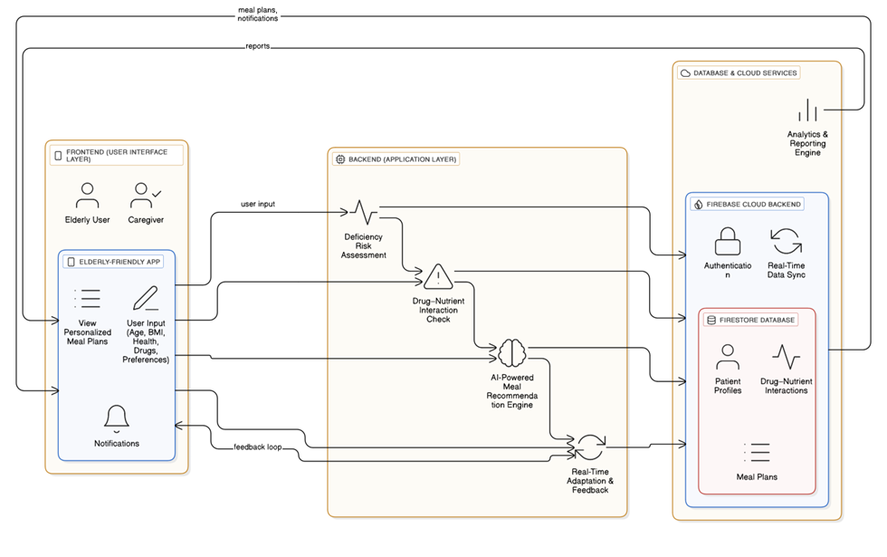
System Overview Diagram
PERSONALIZED MEAL PLAN RECOMMENDATION SYSTEM FOR VITAMIN DEFICIENCY

Slide 21

IT22591098 | JAYALATH J P R J
POLYPHARMACY RISK SCORE
SYSTEM BASED ON DRUG
INTERACTION
Specialization : Information Technology
IT22591098 | Jayalath J.P.R.J | 25-26J-368

Slide 22


Introduction
POLYPHARMACY RISK SCORE SYSTEM BASED ON DRUG INTERACTION
Polypharmacy Risk Score (PRS) is a measure used to evaluate the danger of adverse drug events (ADEs) when patients take multiple medications. which means the use of five or more medications, is very common among elderly patients often leads to adverse drug events.
It is calculated using:
Age >= 65
Drug Count – total number of medications.
High-risk medications - (e.g., anticoagulants, antipsychotics)
Drug–Drug Interactions (DDIs) – severity of interactions between drugs.
Patient-specific details-like drug count,age,kidney/liver function
Solution: Dynamic+ML+DDI severity with patient specific factores to generate a predictive risk
The score is usually presented as Low / Moderate / High risk. With Percentage %
IT22591098 | Jayalath J.P.R.J | 25-26J-368

Slide 23
Research Gap
POLYPHARMACY RISK SCORE SYSTEM BASED ON DRUG INTERACTION
Features | Research 1 | Research 2 | Research 3 | Research 4 | Proposed
Drug Count and Age-based Scoring
Use of Patient-specific Factors (age,drug count, kidney/liver function)
Integration of DDI Severity for polypharmacy Risk Score
Dynamic ML powered + EB Polypharmacy Risk Score System
Clinical Decision Support (Alerts &Recommendation
Addressed
Not Addressed
IT22591098 | Jayalath J.P.R.J | 25-26J-368

Slide 24

Overview of Shortcomings
POLYPHARMACY RISK SCORE SYSTEM BASED ON DRUG INTERACTION
Research Gap
Shortcomings in the Existing System
How to Address it
Current polypharmacy scoring systems mainly focus on drug count and basic patient factors, while ignoring drug-drug interaction (DDI) severity
Add patient-specific factors like age,drug count,high risk drug, kidney/liver function. An base on
Integrate DDI severity levels (mild, moderate, severe) into the risk score.
Risk is too simple and not accurate for real patients
Dangerous drug combinations are missed in the score.
Use Machine Learning + Evidence-Based PRS to create a dynamic, real-time system with alerts and recommendations
there is no standardized, dynamic, and predictive PRS model that integrates DDI severity + patient-specific factors for clinical use.
Existing systems are fixed, not smart, and give little help to doctors.
IT22591098 | Jayalath J.P.R.J | 25-26J-368

Slide 25
Methodology
POLYPHARMACY RISK SCORE SYSTEM BASED ON DRUG INTERACTION
Data Collection & Preprocessing
Gather patient patient related data and Drug-Drug Interaction (DDI) data from trusted sources
(e.g. DrugBank,Kaggle data set).
Preprocessing & Feature Engineering
Clean and standardize data, extract key features like drug count, age and DDI severity
Model Development+Risk Scoring Framework
Train Machine Learning models combined with an Evidence-Based Scoring Formula (EB-PRS). personalized Polypharmacy Risk Score (Low/Moderate/High) updated dynamically with prescription.
System Implementation
Implement a dashboard interface to display scores, alerts, and recommendations.
Development Stages
IT22591098 | Jayalath J.P.R.J | 25-26J-368

Slide 26
POLYPHARMACY RISK SCORE SYSTEM BASED ON DRUG INTERACTION
Key Domains of Knowledge Used
Machine Learning & AI → To build a predictive model for polypharmacy risk using patient and DDI data.
Healthcare Informatics → To manage patient records, drug data, and DDI knowledge bases.
Software Engineering → To develop the risk scoring engine and dashboard for clinicians.
ML Tools → XGBoost (for predictive modeling).
Data Sources → Kaggle datasets (for drug–drug interactions & patient data).
Implementation → Python (ML) + Next stack (dashboard) + MongoDB(data storage).
Accuracy Metrics – measure sensitivity, specificity, precision, and recall against clinical standards.
Clinical Validation → Compare system predictions with real-world ADE cases and pharmacist feedback.
User Feedback – gather patient and provider input on feasibility, compliance, and satisfaction.
Data Sources → Open datasets (DrugBank, Kaggle).
Ethics → Use de-identified patient data to ensure privacy and ethical clearance.
Technologies Utilized
Evaluation & Success Criteria
Data Availability & Ethics
IT22591098 | Jayalath J.P.R.J | 25-26J-368

Slide 27
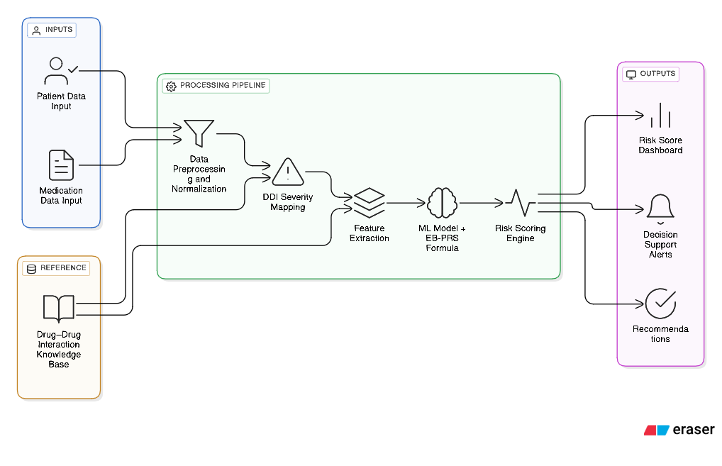
SYSTEM OVERVIEW DIAGRAM
POLYPHARMACY RISK SCORE SYSTEM BASED ON DRUG INTERACTION
Real-world Use
Clinicians get visual risk scores, warnings, and alternatives during prescribing.
IT22591098 | Jayalath J.P.R.J | 25-26J-368

Slide 28
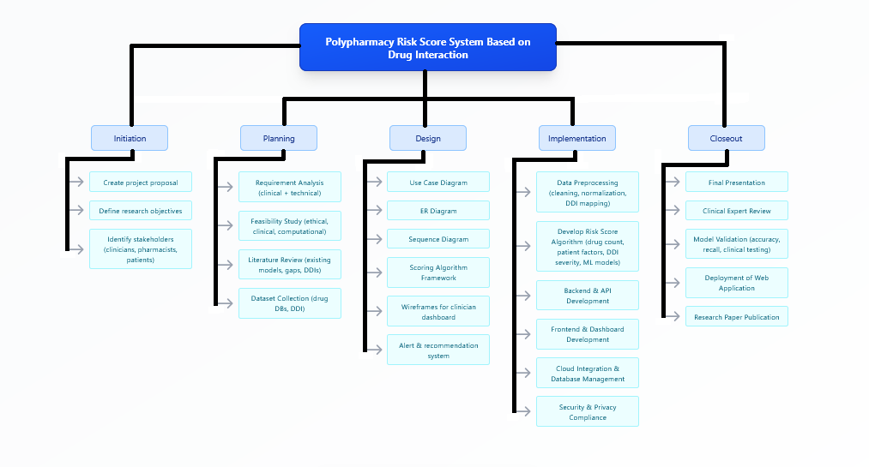
POLYPHARMACY RISK SCORE SYSTEM BASED ON DRUG INTERACTION
WORK BREAKDOWN STRUCTURE
IT22591098 | Jayalath J.P.R.J | 25-26J-368

Slide 29

It22600516 | Tharaka B W P
PERSONALIZED MENTAL HEALTH
AND LIFESTYLE ADVISORY SYSTEM
FOR GERIATRIC PATIENTS
Specialization : Information Technology
IT22600516 | Tharaka B.W.P | 25-26J-368

Slide 30


Introduction & Background
The AI Lifestyle & Mental Wellness Companion is designed to support elderly patients managing polypharmacy by providing drug free, personalized guidance for mental health and daily living.
Mental health and facial expressions
checking for advice
How can an AI companion support geriatric patients at risk of polypharmacy in managing well-being alongside medical
care
Integrating the polypharmacy risk score for advice
Drug free personalized guidance for improve lifestyle
IT22600516 | Tharaka B.W.P | 25-26J-368

Slide 31



Objectives
Specific Objectives
Main Objective
Integrate polypharmacy risk scores
Collect and analyze patient-reported data
Personalized lifestyle recommendations
Drug-free mental health support
Maily motivational check-ins
To design and develop an AI-based Lifestyle & Mental Wellness Companion that provides drug-free, personalized guidance for geriatric patients, especially those with polypharmacy risks.
IT22600516 | Tharaka B.W.P | 25-26J-368

Slide 32
System Comparison
Features | Drug Interaction / Polypharmacy Risk[1] | Health care system [2] | Mental Health Chatbots [3] | Proposed Solution
Integrates polypharmacy risk score into advice | No | No | No | Yes
Uses patient reported + facial expression data for emotion | No | Yes | No | Yes
Drug-free mental wellness interventions (mindfulness, breathing, journaling) | No | No | No | Yes
Personalized lifestyle guidance (sleep, activity, routine) | No | Yes | Yes | Yes
Single integrated platform (polypharmacy + emotion + lifestyle) | No | No | No | Yes
IT22600516 | Tharaka B.W.P | 25-26J-368

Slide 33


Methodology
Modular & Iterative Development Stages
Data Collection : Patient reported inputs (stress, sleep quality, daily routines)
polypharmacy risk score
facial expression data (via webcam)
Model Development : Emotion Detection : CNN model
Mental Health : Random Forest Classifier
Polypharmacy Risk Score Integration
Advice Mapping: Rule-based + decision-tree
System Integration : Polypharmacy risk score, emotion detection, and self-reports to generate lifestyle advice.
Testing & Validation : Evaluate accuracy, usability, and reliability with simulated and real-world data.
Deployment : Host web platform and make it accessible to patients and caregivers.
IT22600516 | Tharaka B.W.P | 25-26J-368

Slide 34

Methodology
Key Domains of Knowledge Used
Technologies Utilized
Artificial Intelligence & Machine Learning - mental health and facial expressions detection
Affective Computing & Human–Computer Interaction
Data Science & Behavioral Analytics – Analysis of daily lifestyle patterns
ML Tools : Scikit-learn, TensorFlow
Data Sources : Kaggle datasets (Life style guidence).
Implementation : Python (ML) + Next stack (dashboard) + MongoDB(data storage).
Evaluation & Success Criteria
Data Availability & Ethics
Data Sources : Open datasets, Anonymized synthetic patient data
Ethics : Ensure informed consent for data collection,
Maintain strict data privacy , Clearly define boundaries
Model Performance Metrics
User Testing
Comparison
Safety Evaluation
IT22600516 | Tharaka B.W.P | 25-26J-368

Slide 35
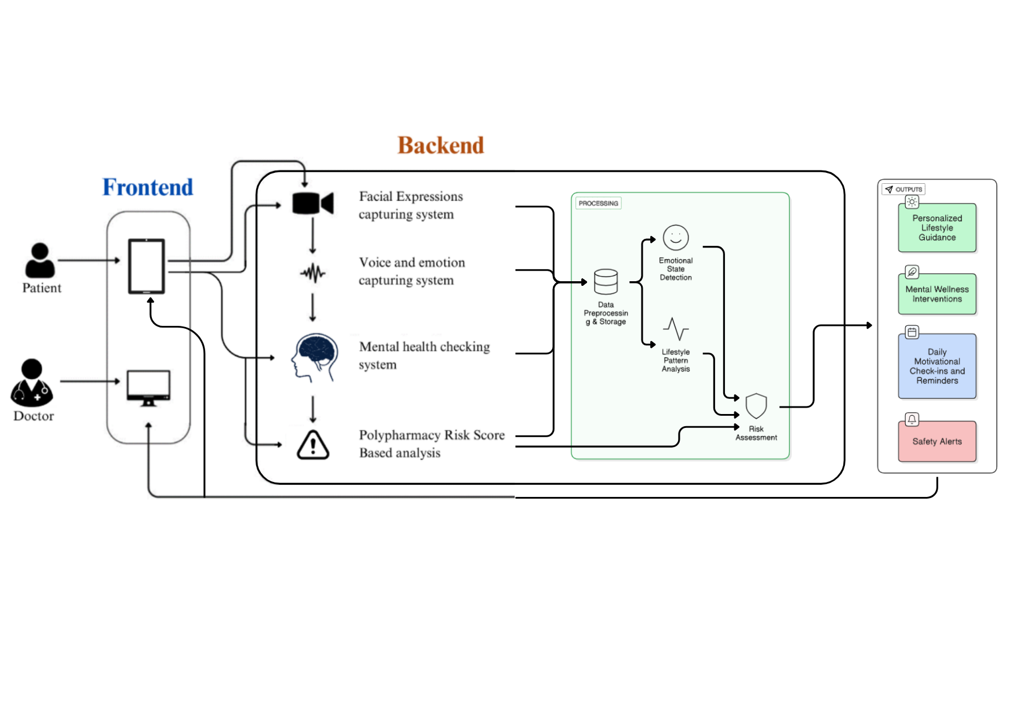
SYSTEM OVERVIEW DIAGRAM
IT22600516 | Tharaka B.W.P | 25-26J-368

Slide 36
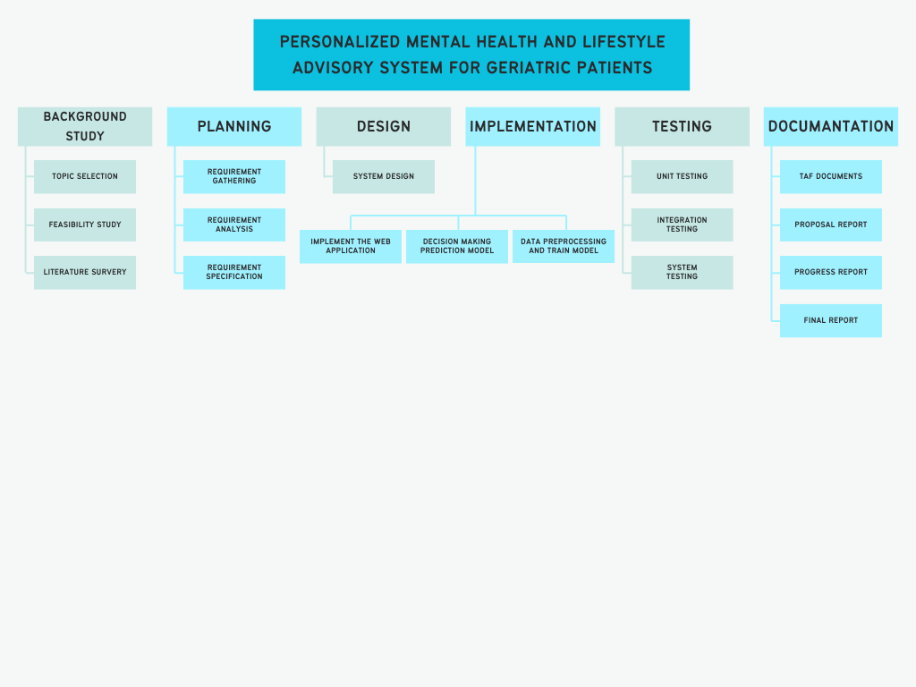
Work Breakdown Structure
IT22600516 | Tharaka B.W.P | 25-26J-368

Slide 37





PROJECT OVERVIEW & COMMERCIALIZATIONES WORKFLOW
Target Market & Customer Profile
Ability of Commercialization
Investment / Cost & Recovery:
:
Elderly individuals on long-term medications (primary users).
Caregivers and family members seeking proactive health monitoring.
Offered as web app for hospitals, clinics, and users.
Subscription/licensing model for healthcare providers.
Integrates with existing health systems for wider adoption.
Cloud servers
app infrastructure
Recovery Strategy:
Subscription plans for clinics and hospitals.
Premium model for individual users with optional premium features.
Partnerships with health insurers or wellness programs.
Value Proposition:
Early detection of vitamin deficiencies, improving patient health outcomes.
Personalized dietary & supplementation recommendations.
Reduces hospital visits and lab testing costs.
Intellectual Property Rights
:
Proprietary AI algorithms for predictive deficiency detection.
Database schema, recommendation engine, and app design protected under copyright.
Potential for patenting predictive model and unique multi-factor integration method.

Slide 38


